Slide 1
IT Project Management
Project Cost Management

Slide 2
Project Cost Management
Cost management is another trouble spot for IT projects
IT projects have a poor track record for meeting cost goals

Slide 3
Project Cost Management
Project cost management is the processes required to ensure that the project is completed within an approved budget
A successful project is one delivered “On time, within budget and with the required quality”

Slide 4
Project Cost Management Processes
Cost estimating: Developing an approximation
or estimate of the costs of the resources needed to complete a project.
Cost budgeting: Allocating the overall cost
estimate to individual work items to establish a
baseline for measuring performance.
Cost control: Controlling changes to the project
budget.

Slide 5
Basic Principles of Cost Management
Profits are revenues minus expenses
Profits =revenues – expenses
Life cycle costing is estimating the cost of a project plus the maintenance costs of the products it produces
Life cycle costing=cost of a project + maintenance costs of
the product it produces

Slide 6
Basic Principles of Cost Management
Cash flow analysis is determining the estimated annual costs and benefits for a project
Benefits and costs can be tangible or intangible, direct or indirect
Sunk cost should not be a criteria in project selection

Slide 7
Cost Estimation Tools and Techniques
3 basic tools and techniques for cost estimates:
analogous or top-down: use the actual cost of a previous, similar project as the basis for the new estimate
bottom-up: estimate individual work items and sum them to get a total estimate
parametric: use project characteristics in a mathematical model to estimate costs (COCOMO)

Slide 8
Cost Estimation Tools and Techniques
Analogous or top-down estimating
Paramatic estimatin
Bottom-up estimating
Original model
COCOMO
Semidetached model
Abundant model
Basic level
Intermediate level
Detail level

Slide 9
Organic, Semidetached and Embedded software projects
Boehm postulated that any software development project can be classified into one of the following three categories based on the development complexity:
organic
semidetached
embedded.

Slide 10
Organic software projects
A development project can be considered of organic type, if the project deals with developing a well understood application program, the size of the development team is reasonably small, and the team members are experienced in developing similar types of projects.

Slide 11
Semidetached software projects
A development project can be considered of semidetached type, if the development consists of a mixture of experienced and inexperienced staff.
Team members may have limited experience on related systems but may be unfamiliar with some aspects of the system being developed.

Slide 12
Embedded software projects
A development project is considered to be of embedded type, if the software being developed is strongly coupled to complex hardware, or if the stringent regulations on the operational procedures exist.

Slide 13
Constructive Cost Model (COCOMO)
COCOMO (Constructive Cost Estimation Model) was proposed by Boehm [1981].
According to Boehm, software cost estimation should be done through three stages: Basic COCOMO, Intermediate COCOMO, and Detailed COCOMO.
COCOMO II is a computerized model available on the Web

Slide 14
COCOMO levels - Basic Level
The basic COCOMO model gives an approximate estimate of the project parameters.
Basic Level:
Use : determine size and schedule
Gives: fast, roughs estimate of small to medium size project.

Slide 15
COCOMO levels - Intermediate level
Use: additional variables to determine effort. Called: Cost drivers
This is related to product, personal and project attributes. This will result in more effort or less effort required for the software project. The product of the cost drives known as Environmental adjustment Factors ( EAF)

Slide 16
COCOMO levels - Detail level
This level build upon intermediary COCOMO model by introducing the additional capabilities of phase sensitive effort multipliers.

Slide 17
The basic COCOMO
The basic COCOMO estimation model is given by the following expressions:
Effort = a¹ х (KLOC)^{a2} PM
Tdev = b¹ x (Effort)^{b2} Months
Where
KLOC is the estimated size of the software product expressed in Kilo Lines of Code,
a¹, a², b¹, b² are constants for each category of software products,

Slide 18
The basic COCOMO
Tdev = b¹ x (Effort)^{b2} Months
Where
Tdev is the estimated time to develop the software, expressed in months,
Effort is the total effort required to develop the software product, expressed in person months (PMs).

Slide 19
Effort for original model:
E= 2.4 x (size) ^{1.05}
Semidetached model:
E= 3.0 x (size) ^{1.12}
The abundant model
E= 3.6 x (size) ^{1.26}

Slide 20
Basic COCOMO Project duration Estimate
original model:
TDEV= 2.5 x (E) ^{0.38}
Semidetached model:
TDEV= 2.5 x (E) ^{0.35}
The abundant model
TDEV= 2.5 x (E) ^{0.32}

Slide 21
Basic COCOMO Average Staff Estimate
Average Staff: SS
ss= Effort / TDEV
4 Basic COCOMO Productivity Estimate
Productivity = Size / Effort

Slide 22
Example:
A development project is size of 7.5 kloc and evaluated as being simple. Find the value for average staff, productivity.

Slide 23
original model:
E= 2.4 x (size) ^{1.05}
⁼ 2.4 (7.5) ^{1.05}
TDEV= 2.5 x (E) ^{0.38}
⁼ 2.5 [ 2.4 (7.5) ^{1.05} ] ^{.38}
Average Staff= Effort / TDEV
= (2.4 (7.5) ^{1.05} )/(2.5 [ 2.4 (7.5) ^{1.05} ] ^{.38} )
Productivity = Size / Effort
= 7.5/ (2.4 (7.5) ^{1.05} )

Slide 24
Cocomo 11 model estimate the required effort of a project ( measured in Person –Month PM) based primarily on your estimate of the software project’ size (as measured in thousands of SLOC, ksloc). A project of 1.00 and exponent E of 1.0997 . Assuming that the project is projected to consist of 8,000 Sours Line of Code. Estimate the Person-Month effort required to complete the project by COCOMO 11 model.

Slide 25
Typical Problems with IT Cost Estimates
Developing an estimate for a large software project is a complex task requiring a significant amount of effort. Also estimates are done at various stages of the project
Many people doing estimates have little experience doing them. Try to provide training and mentoring

Slide 26
Typical Problems with IT Cost Estimates
People have a bias toward underestimation. Review estimates and ask important questions to make sure estimates are not biased
Management wants a number for a bid, not a real estimate. Project managers must negotiate with project sponsors to create realistic cost estimates

Slide 27
Earned Value Management (EVM)
EVM is a project performance measurement technique that integrates scope, time, and cost data
Given a baseline (original plan plus approved changes), you can determine how well the project is meeting its goals
You must enter actual information periodically to use EVM. Figure 7-1 shows a sample form for collecting information

Slide 28
Earned Value Management Terms
The planned value (PV), formerly called the budgeted cost of work scheduled (BCWS), also called the budget, is that portion of the approved total cost estimate planned to be spent on an activity during a given period
Actual cost (AC), formerly called actual cost of work performed (ACWP), is the total of direct and indirect costs incurred in accomplishing work on an activity during a given period
The earned value (EV), formerly called the budgeted cost of work performed (BCWP), is an estimate of the value of the physical work actually completed

Slide 29
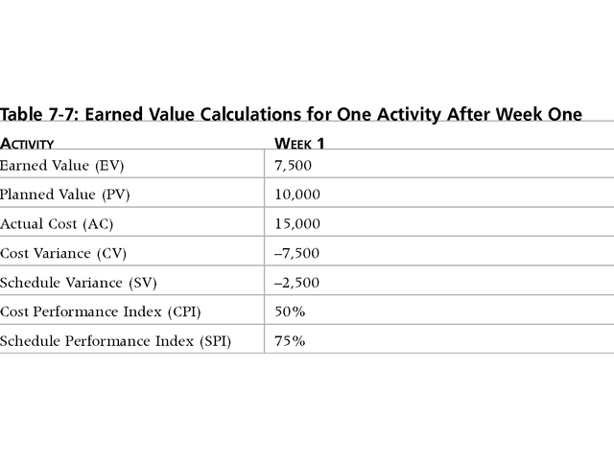
Earned Value Calculations

Slide 30
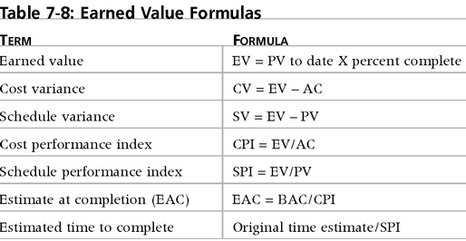
Earned Value Formulas

Slide 31
Cost Budgeting
Cost budgeting involves allocating the project cost estimate to individual work items over time.
The WBS is a required input for the cost budgeting process because it defines the work items.
Important goal is to produce a cost baseline:
– A time-phased budget that project managers use to measure and monitor cost performance.

Slide 32
Cost Control
Project cost control includes:
– Monitoring cost performance.
– Ensuring that only appropriate project changes are
Included in a revised cost baseline.
– Informing project stakeholders of authorized changes to the project that will affect costs.
Many organizations around the globe have
problems with cost control.

Slide 33
Conclusion
To summarize some key points:
Estimates are really management targets.
Collect as much information about previous projects as possible.
Use more than one method of estimating.
Top-down approaches will be used at the earlier stages of project planning while bottom-up approaches will be more prominent later on.
Be careful about using other people’s historical productivity data as a basis for your estimates, especially if it comes from a different environment.

